Slide 1
BitTiger Capstone Project - Music Box Churn Prediction
Jiaming Chen
Tianyi Fang
Ziwei Duan

Slide 2
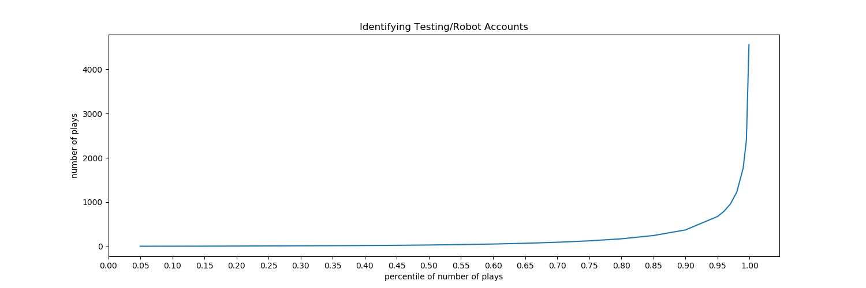
I. Load - Extract - Transform
Used Spark to parse log files into RDD, as Pandas fell short of manipulating 14+G data
Performed sanity check on PLAY logs, counting total number of play logs
First Obviously some uid are testing accounts (i.e. robots) and should be excluded from the population.
We removed uids whose total number of plays falls above the 99.5 percentile, as we consider them as robots/ outliers
Sanity checks on play_time and song_length suggest some logs are recorded in milli-seconds, and therefore, we converted them into seconds.

Slide 3
I. Load - Extract - Transform (con’t)
Defined Cut-Off Date = 4/29/2017 to Label Churn vs. Active
Uid active by the cut-off date are our study population
If they still play Music Box between 4/30 and 5/12 (2-week observation window), then we labeled them as active; otherwise we labeled them churn.
- valid_uid = 864,428 (99.5 percentile of all uid, assuming the top 0.5 percentile are robot accounts)
- play_population_uid = 557,207 (valid_uid that has play record by 4/29)
Out of 557K play_population_uid, 357K churned. Churn ratio = 64%
Downsampled Population
- Adjust for difference in churn vs. active split.
- After downsampling, total uid = 21,622 (churn = 11,554, active = 10,068)
Merge PLAY, DOWNLOAD, SEARCH

Slide 4
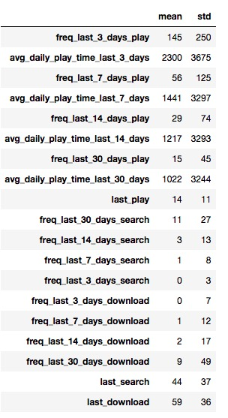
II. Feature Engineering
Frequency of Play, Download, Search within last 3, 7, 14 and 30-day window.
Recency of Last Play, Download, Search
Average Daily Play Time Merge PLAY

Slide 5
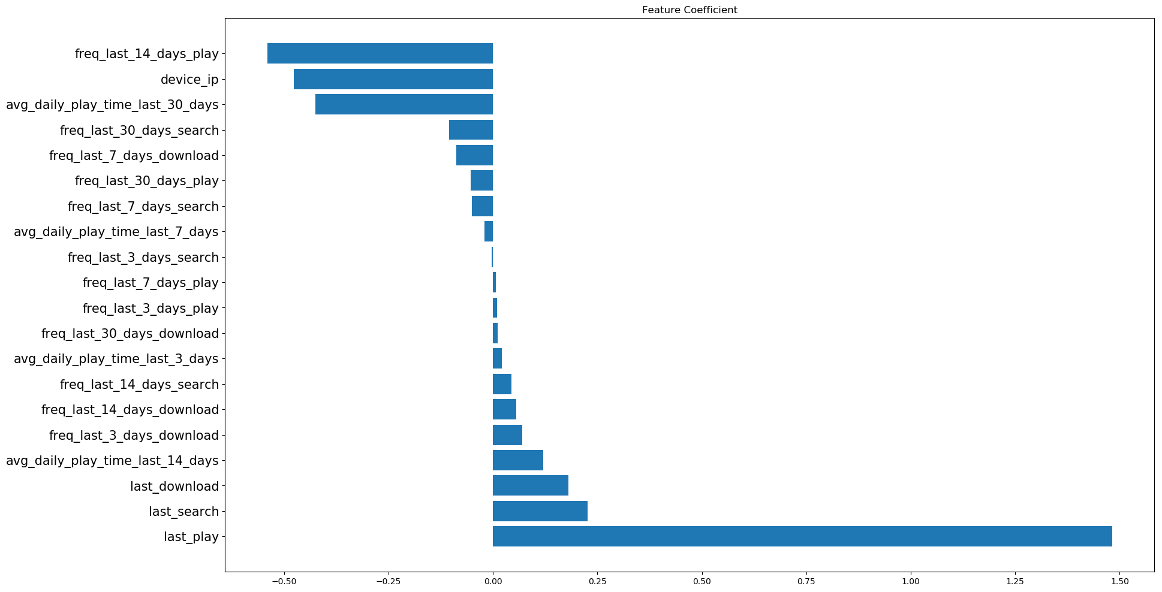
III. Model Fitting - Logistic Regression
Standardized all numerical features before fitting logistic regression
Created dummy variable to represent device (category variable)
Split sample into Test and Training data

Slide 6
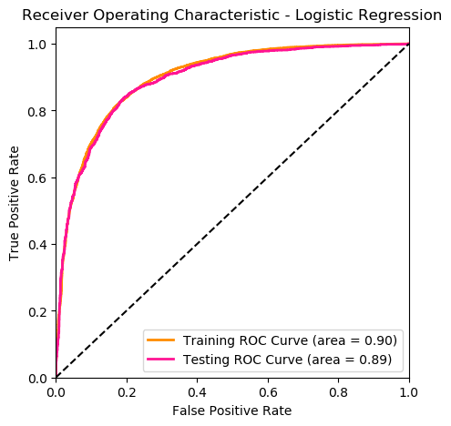
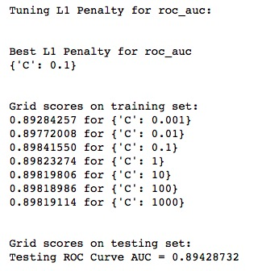
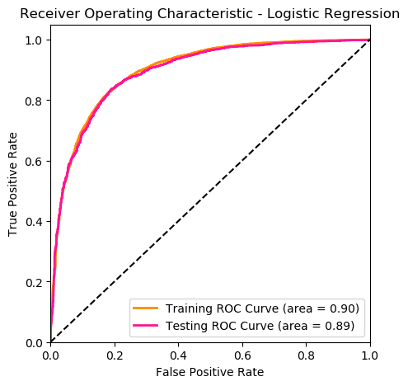
IV. Grid Search
AUC of Testing Data -
No L1 Penalty (0)
Tried to optimize model by experimenting with L1 penalty on scale of log10.
Difference in AUC is de miniscule, supporting the use of simpler model.
AUC of Testing Data -
Best L1 Penalty (0. 1)

Slide 7
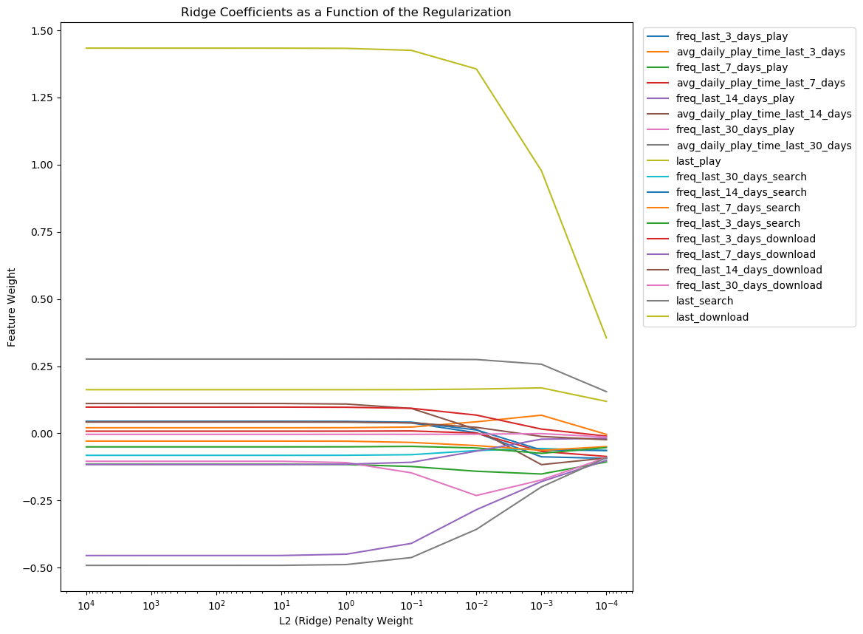
V. Model Regularization
Days Since Last Play
Days Since Last Search
Days Since Last Download
Play Freq Last 14 Days
Avg. Daily Play Time in Last 30 Days

Slide 8

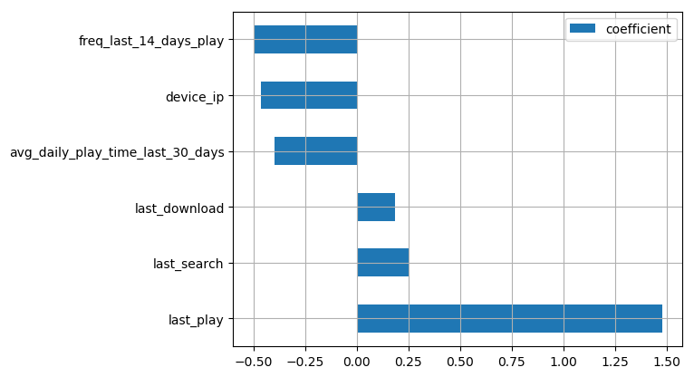
VI. A Simpler Model
Based on results from Grid Search and Model Regularization, I concluded the logistic regression model with a sub-set of features (6 out of 20 features)
Simpler model enhances interpretability without sacrificing prediction performance.

